Slide 1
Emotion and Rationality in EU Communication
“They may forget what you said, but they will remember how you made them feel”
(Carl W. Buechner)
Text as Data – Research Presentation – December 1st, 2022
Ma. Adelle Gia Arbo, MDS 2023
Janine De Vera, MDS 2023
Benedikt Ströbl, MDS 2023

Slide 2

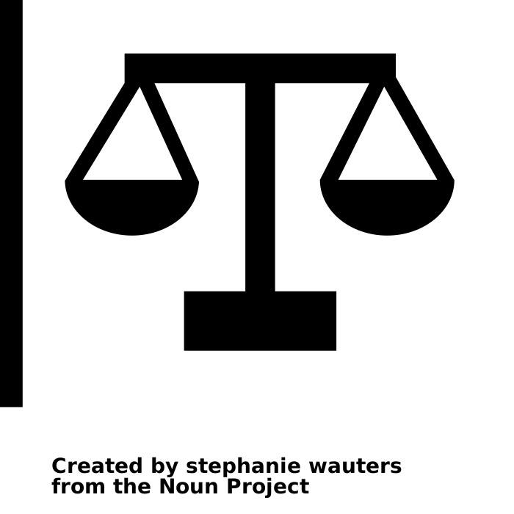

Investigating the use of reason and emotion in communicating politics of the EU Commission
The relevance of this question is intuitive
Politicians around the globe combine rational and emotional language and choose the right balance depending on factors that are not yet understood (Gennaro et al. 2021)
RQ1:
Does emotion in language respond to major crises affecting the EU?
RQ2:
How does language vary across political topics?
RQ3:
How does emotion and reason vary by gender and political ideology of commissioners?
According to Aristotle, persuasion is achieved with choosing the right balance between affect and logical argumentation in language (Aristotle, Rhetoric)
RQ1:
How does emotion in language vary across time and events?
Has there been a shift in communication with Ursula von der Leyen taking over the EU Commission in 2019?
Does emotion in language respond to major crises affecting the EU?
Evaluating and processing political communication, it is crucial to understand how context is impacting choice of language
RQ2:
How does emotion in language vary across political topics?
How do political factors affect emotion and reason in language?
Can we identify policy areas that are prone to a certain tone?
The legislative procedure of the EU is centered around the EU commission and its power to propose new law (Blom-Hansen et al. 2020)
RQ3:
How does emotion and reason vary by gender and political ideology of commissioners?
How does emotion and reason vary by gender/political ideology of commissioners?

Slide 3

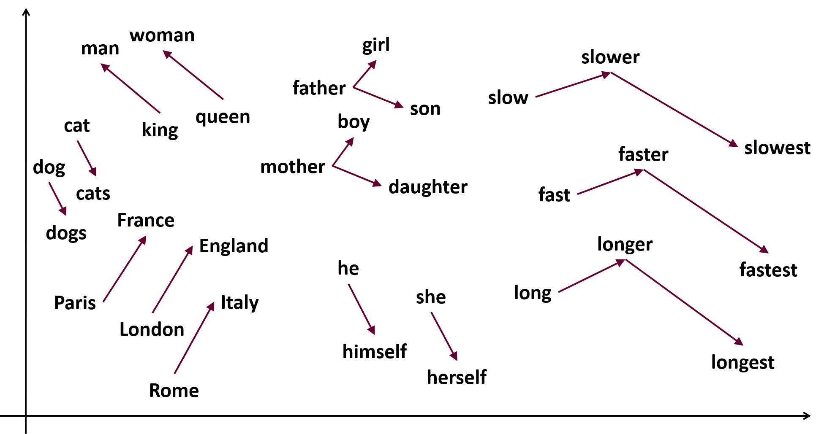
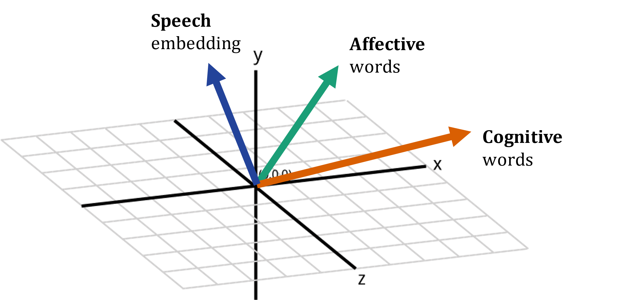
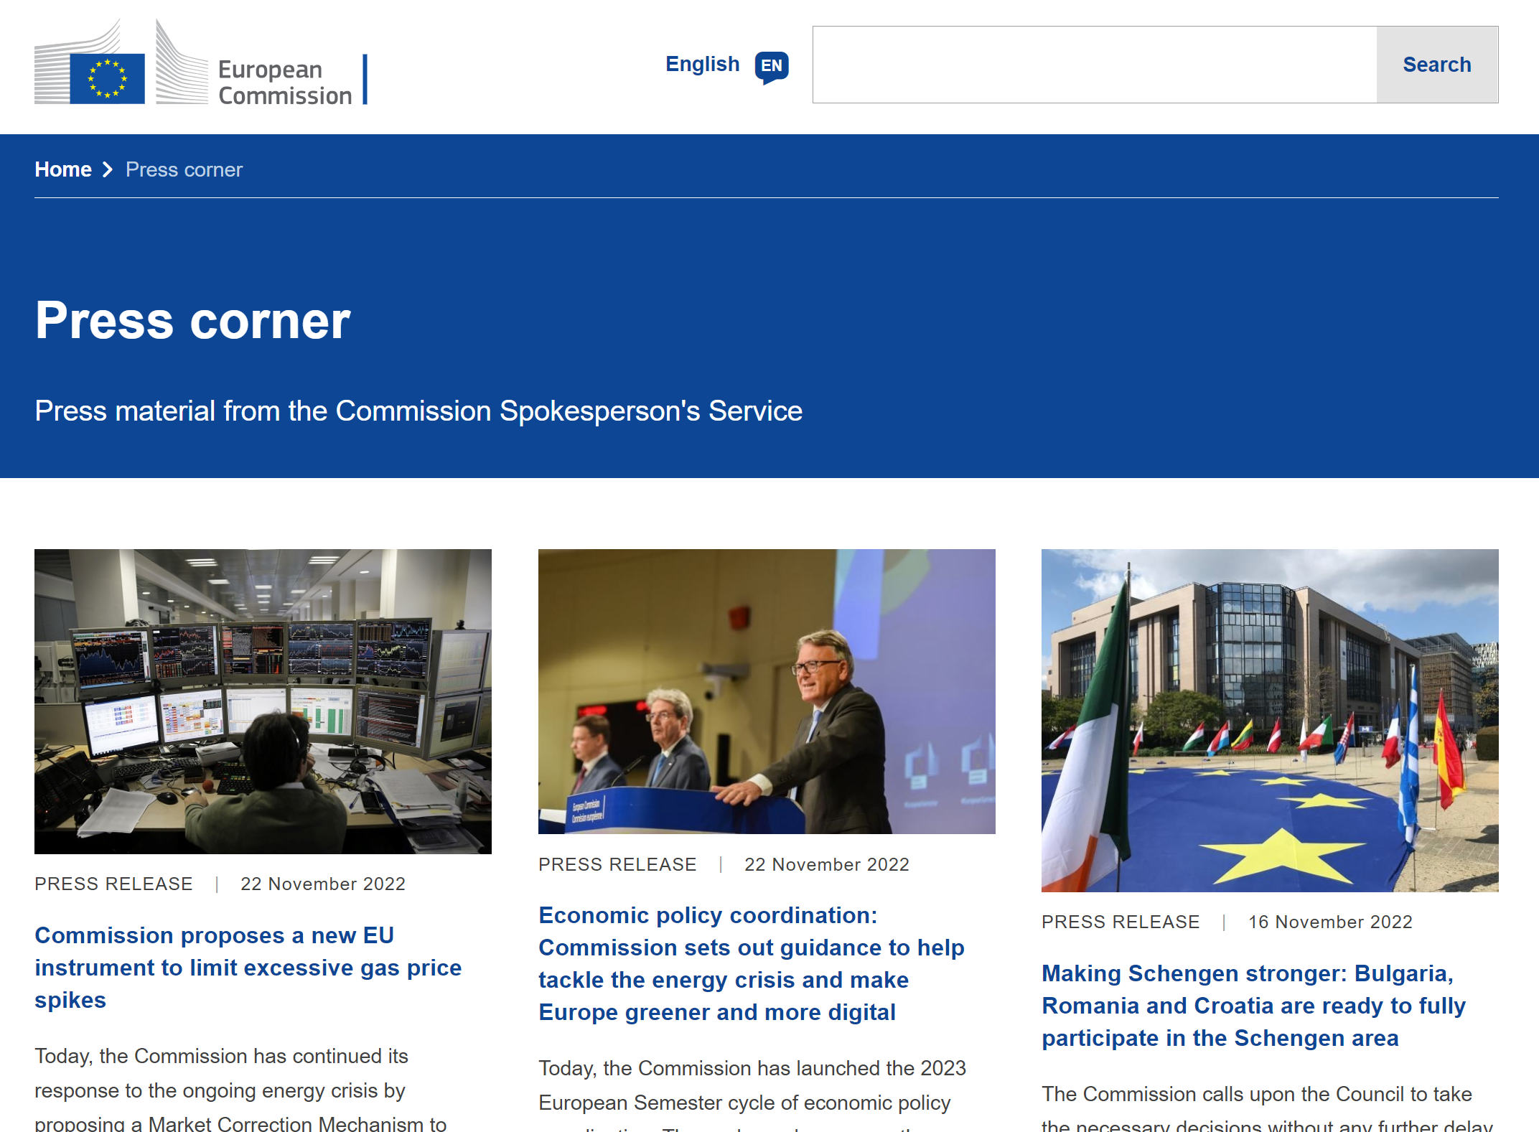
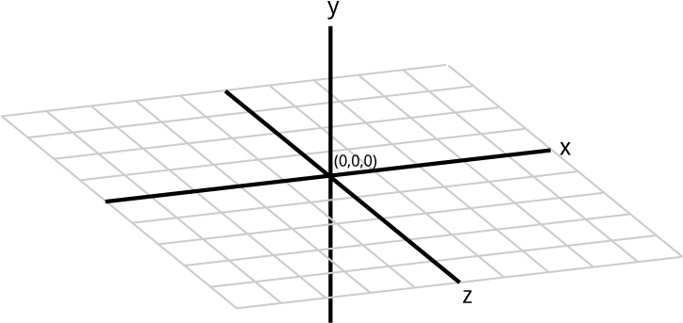
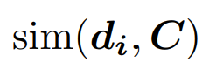
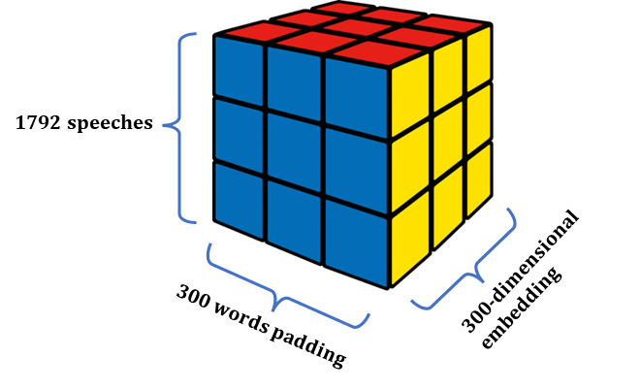
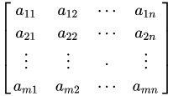
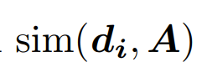
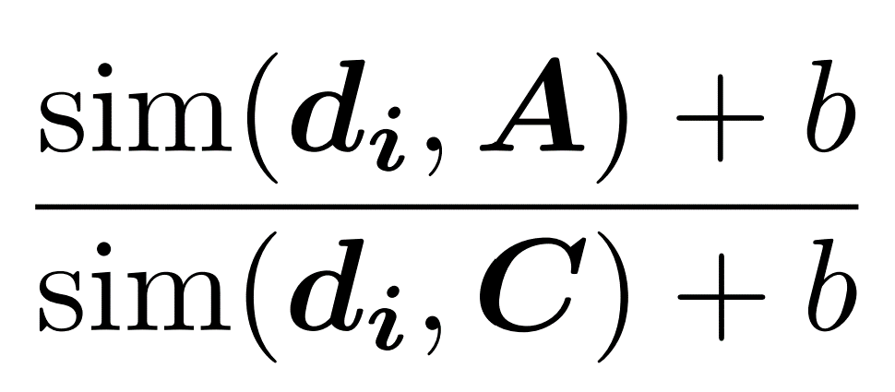
Building document embeddings from word representations in vector space for EU speeches
Data acquisition
Vector representation
Geometric dimensions
Using dynamic web scraping with Selenium, we parsed the EU Commission’s Press Corner to retain all 2150 speeches from the current college members.
Crafting document representations from training word2vec word embeddings on our corpus.
Drawing on two wordlists from the LIWC dictionary (Pennebaker et al. 2015), we also calculate embeddings for all cognitive and affective words and the cosine similarities with speeches.
1792 speeches
1. Using gensim’s implementation, we trained our own word2vec embeddings (Mikolov 2013)
300-dimensional embedding
Filter stop words, special characters, numbers and non-English documents, short words, and tags
300 words padding
Matching political parties of 27 commissioners by hand
2. Using these embeddings and a tfidf dtm, we calculated the weighted average for each document’s word embeddings
3. Getting a 300-dimensional vector representation of each speech in our data set (1792 X 300)
Joining political scores of parties from Chapel Hill Expert Survey data base
Speech embedding
Affective words
Cognition Score:
Cognitive words
Affect Score:
tfidf-weighted mean
Emotion Score:
with b = 1
(Gennaro et al. 2021)

Slide 4
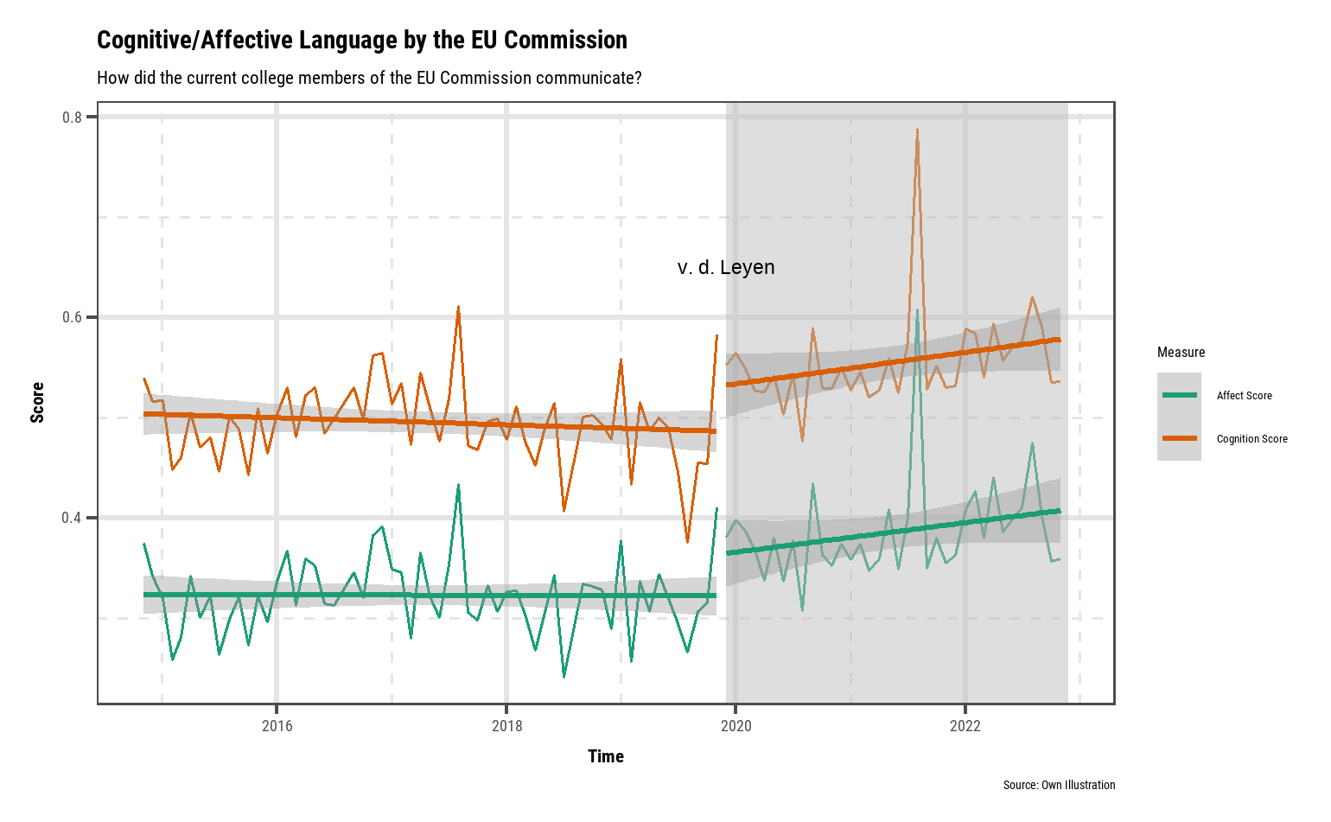
RQ1 – How does emotion in language vary across time and events?
European Parliament elected Ursula von der Leyen President of the next European Commission
RQ1:
Does emotion in language respond to major crises affecting the EU?
RQ2:
How does language vary across political topics?
RQ3:
How does emotion and reason vary by gender and political ideology of commissioners?
Structural break
in 2019
Increase in average emotionality scores of speeches of EU Commissioners
Commissioner speeches use more cognitive than affective language
Highly emotive speeches are associated to major crisis events like COVID-19 outbreak and Ukraine war
To summarize RQ1, we found supporting evidence showing an increase in emotionality when v.d. Leyen took over and EU commissioners’ speeches use highly emotive language during major crisis events.

Slide 5
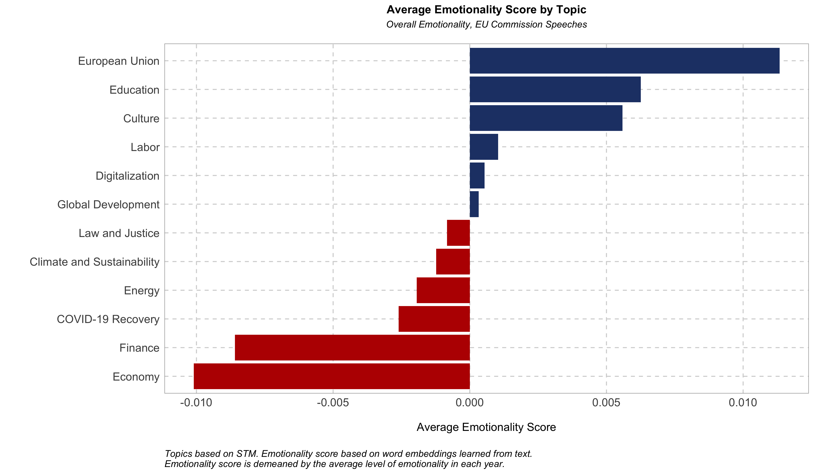
RQ2 – How does emotion in language vary across political topics?
Most emotionally charged speeches reference EU history, values, and key events that shaped the region (e.g. Ukraine war, refugee crisis)
Deriving main topics
RQ1:
Does emotion in language respond to major crises affecting the EU?
RQ2:
How does language vary across political topics?
RQ3:
How does emotion and reason vary by gender and political ideology of commissioners?
12 topics are derived from STM. Each speech is assigned to a main keyword based on the highest document-topic and topic-term probabilities.
Comparing emotionality across topics
Emotionality by topic is calculated by averaging scores over all speeches that fall into the 12 categories. To capture topic-level variation, emotion scores are time demeaned.
Results reveal a clear variation in emotional expression by political topic.
Speeches about economic growth, fiscal reforms, and investments use more cognitive language and are the least emotionally charged.

Slide 6
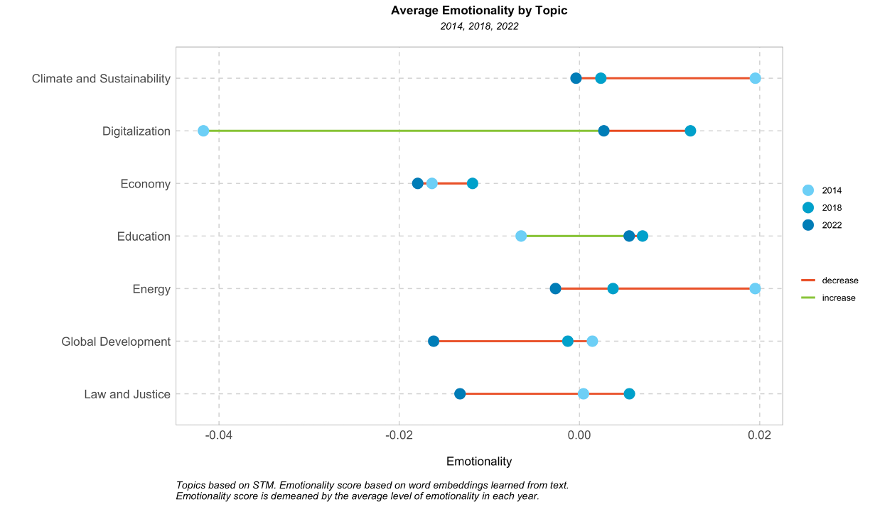
RQ2 – How does language vary across political topics?
RQ1:
Does emotion in language respond to major crises affecting the EU?
RQ2:
How does language vary across political topics?
RQ3:
How does emotion and reason vary by gender and political ideology of commissioners?
Comparing emotionality across time
Emotionality by topic also varies across time.
Speeches about digitalization have become more emotionally charged between 2014 to 2022.
Speeches about climate and energy have become less emotional – less affective words are used compared to cognitive words.
For RQ2 we found that emotionality of speeches vary by political topics. In general, those that deal with more sensitive matters (e.g. conflicts, humanitarian crises) use more affective language.

Slide 7
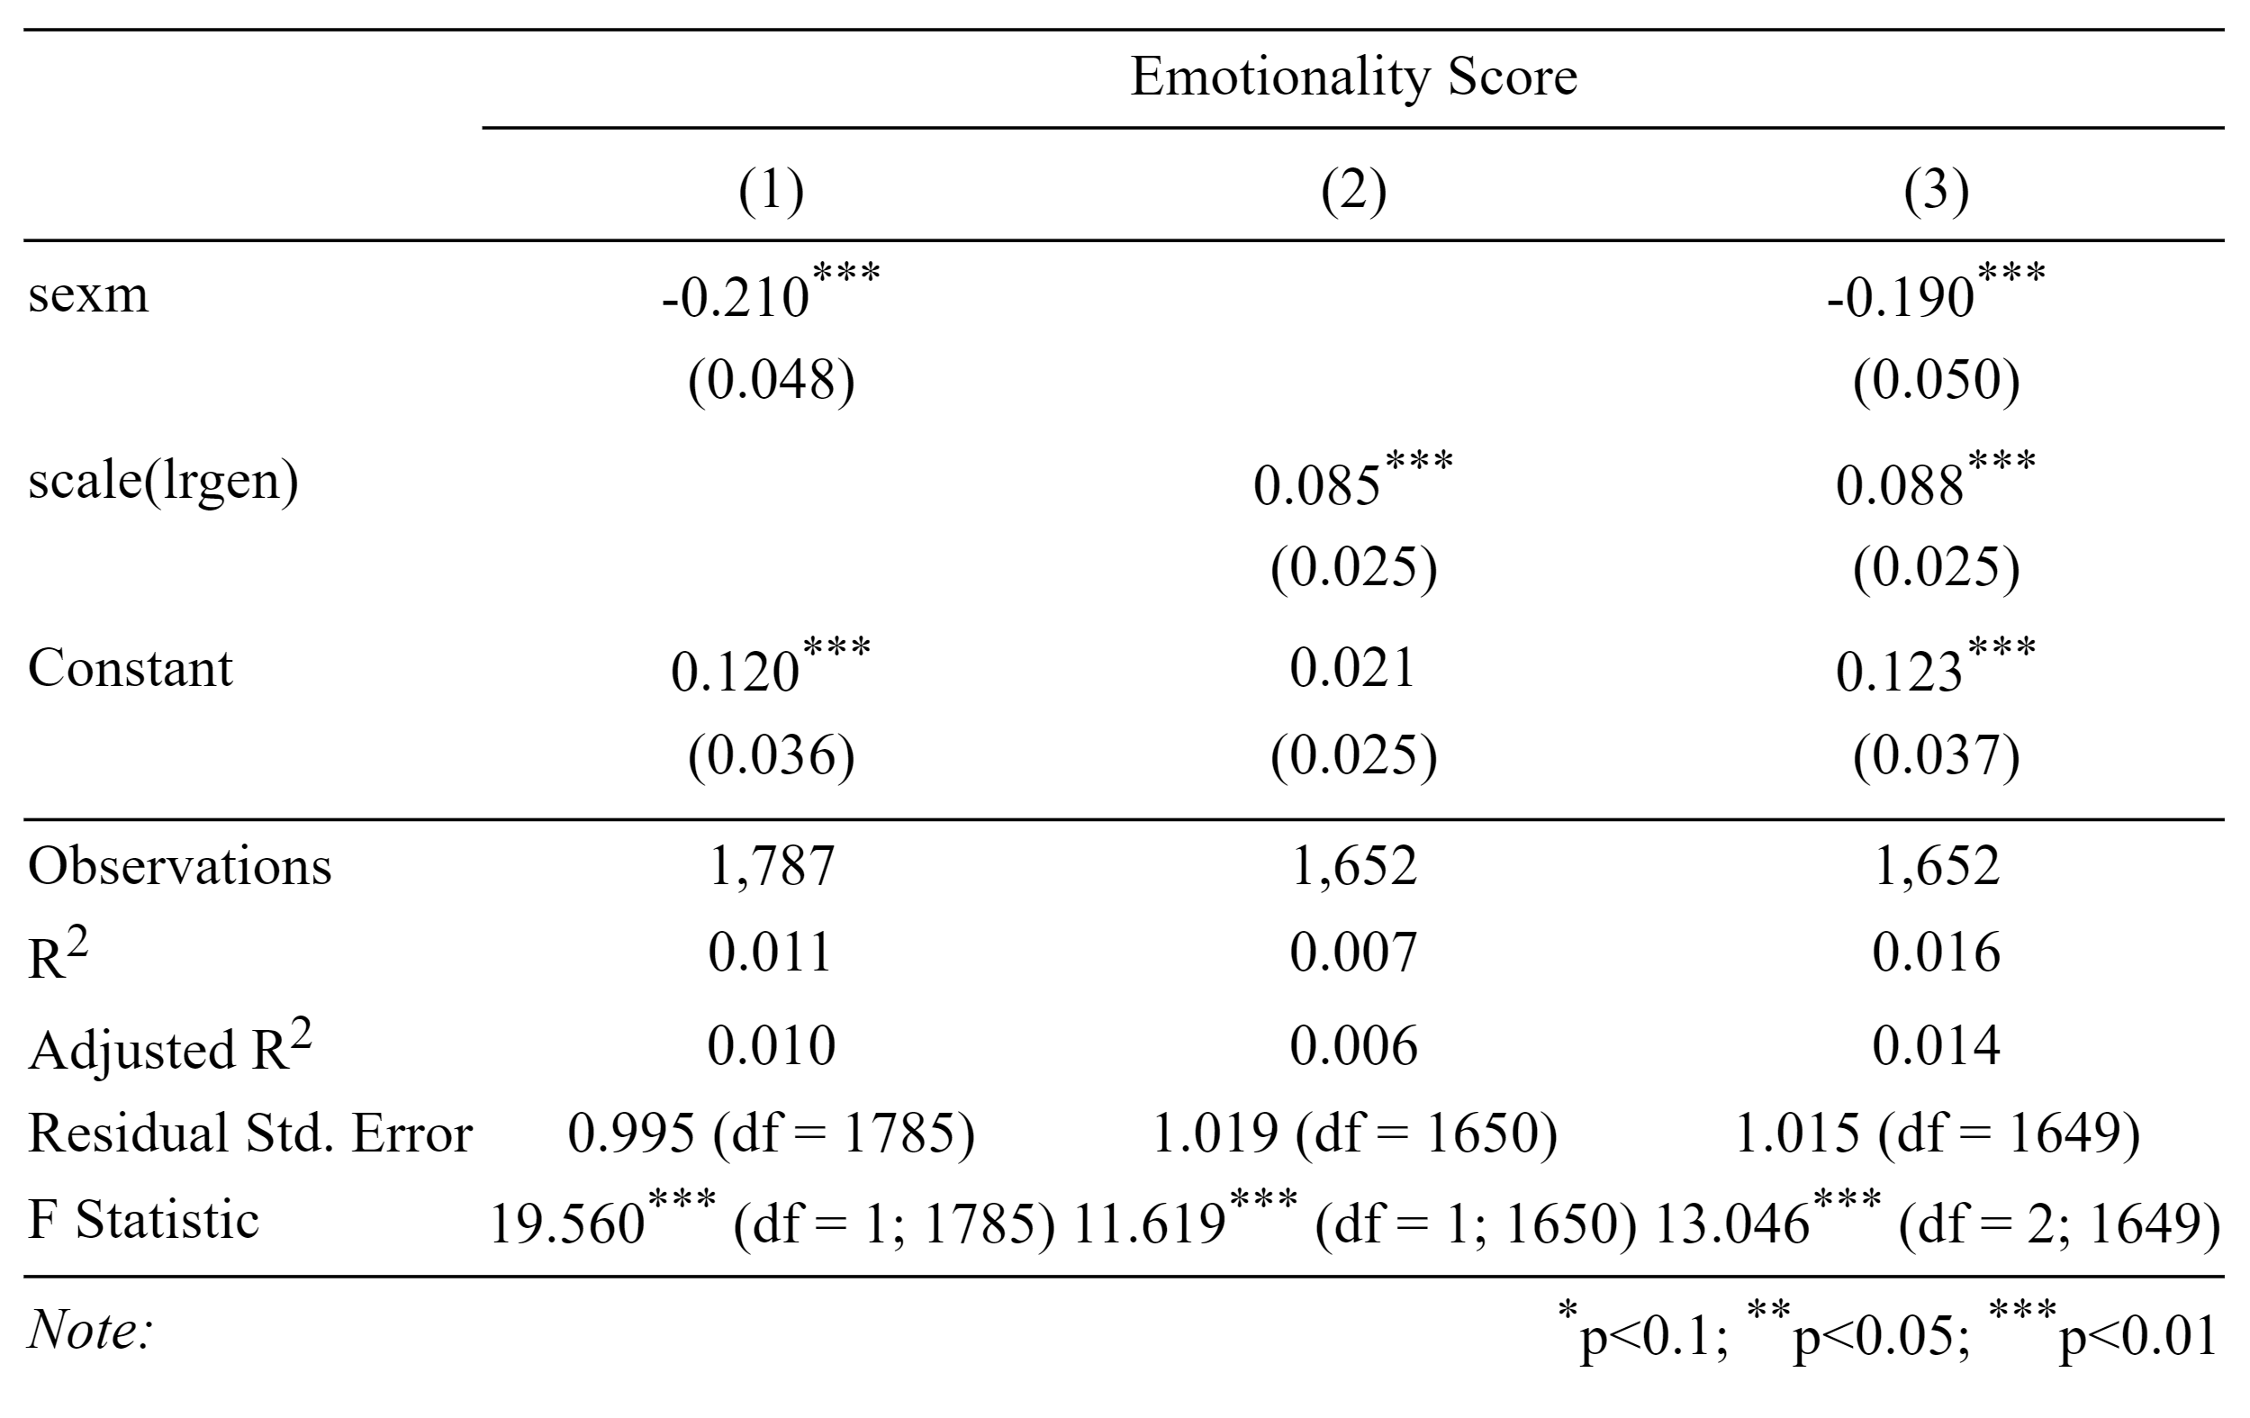
RQ3 – How does emotion and reason vary by gender and political ideology of commissioners?
Effect of Politicians’ Characteristics on Emotionality
Columns show the std. coefficients of politicians’ characteristics on std. emotionality
RQ1:
Does emotion in language respond to major crises affecting the EU?
RQ2:
How does language vary across political topics?
RQ3:
How does emotion and reason vary by gender and political ideology of commissioners?
Strong evidence for a negative effect of being a man on emotionality of language
Highly significant evidence for commissioners with a more right-leaning ideology to use more emotional language
Effects hold for the complete model with almost identical p-value indicating very low collinearity
Since we used standardized coefficients, we can also infer that sex has a bigger effect than political ideology
In general, we found strongly supporting evidence for RQ3 and EU commissioners’ characteristics seem to influence their use of emotionality in communication

Slide 8




There is no free lunch – four limitations of our research design we identified and mitigated
1792 speeches
Robustness. Does our design really measure what we claim it does?
Topic identification. Unsupervised structure of STM lacks extensive validity checks.
Data scarcity. Compared to extant studies analyzing speeches, our corpus comprises relatively few speeches from only 8 years. This can lead to biased word embeddings.
Interdependence of college members. We cannot really account for the extent to which commissioners are bound in their communication, thus mitigating the effect of ideology/sex etc.
300-dimensional embedding
300 words padding
Building on the design of Gennaro et al. 2021 who did extensive robustness checking.
We validated the most frequent words defining the topics that showed very strong associations. Also found that LDA gets very similar results.
Very hard to quantify account for. Might be specific for each government - especially EU Commission. We might need to draw on PolSci theory for that.
We extended existing validity checks by using Google’s pretrained word2vec embeddings finding very similar results.
Gennaro (2021) had similar findings for the U.S. case using speech data since 1850s. We expect our results to be valid for more data as well.
Speech embedding
Affective words
Chang et al. 2009 confirmed that human validation is not worse than quantitative measures
Interesting research question for future work!!!
Cognitive words

Slide 9
References
Blom-Hansen, J., & Finke, D. (2020). Reputation and organizational politics: Inside the EU Commission. The Journal of Politics, 82(1), 135-148.
Gennaro, G., & Ash, E. (2022). Emotion and reason in political language. The Economic Journal, 132(643), 1037-1059.
Bakker, R., De Vries, C., Edwards, E., Hooghe, L., Jolly, S., Marks, G., ... & Vachudova, M. A. (2015). Measuring party positions in Europe: The Chapel Hill expert survey trend file, 1999–2010. Party Politics, 21(1), 143-152.
Pennebaker, J. W., Boyd, R. L., Jordan, K., & Blackburn, K. (2015). The development and psychometric properties of LIWC2015.
Chang, J., Gerrish, S., Wang, C., Boyd-Graber, J., & Blei, D. (2009). Reading tea leaves: How humans interpret topic models. Advances in neural information processing systems, 22.

Slide 10
Appendix
Some less pretty but still informative insights to better understand our research design and results

Slide 11
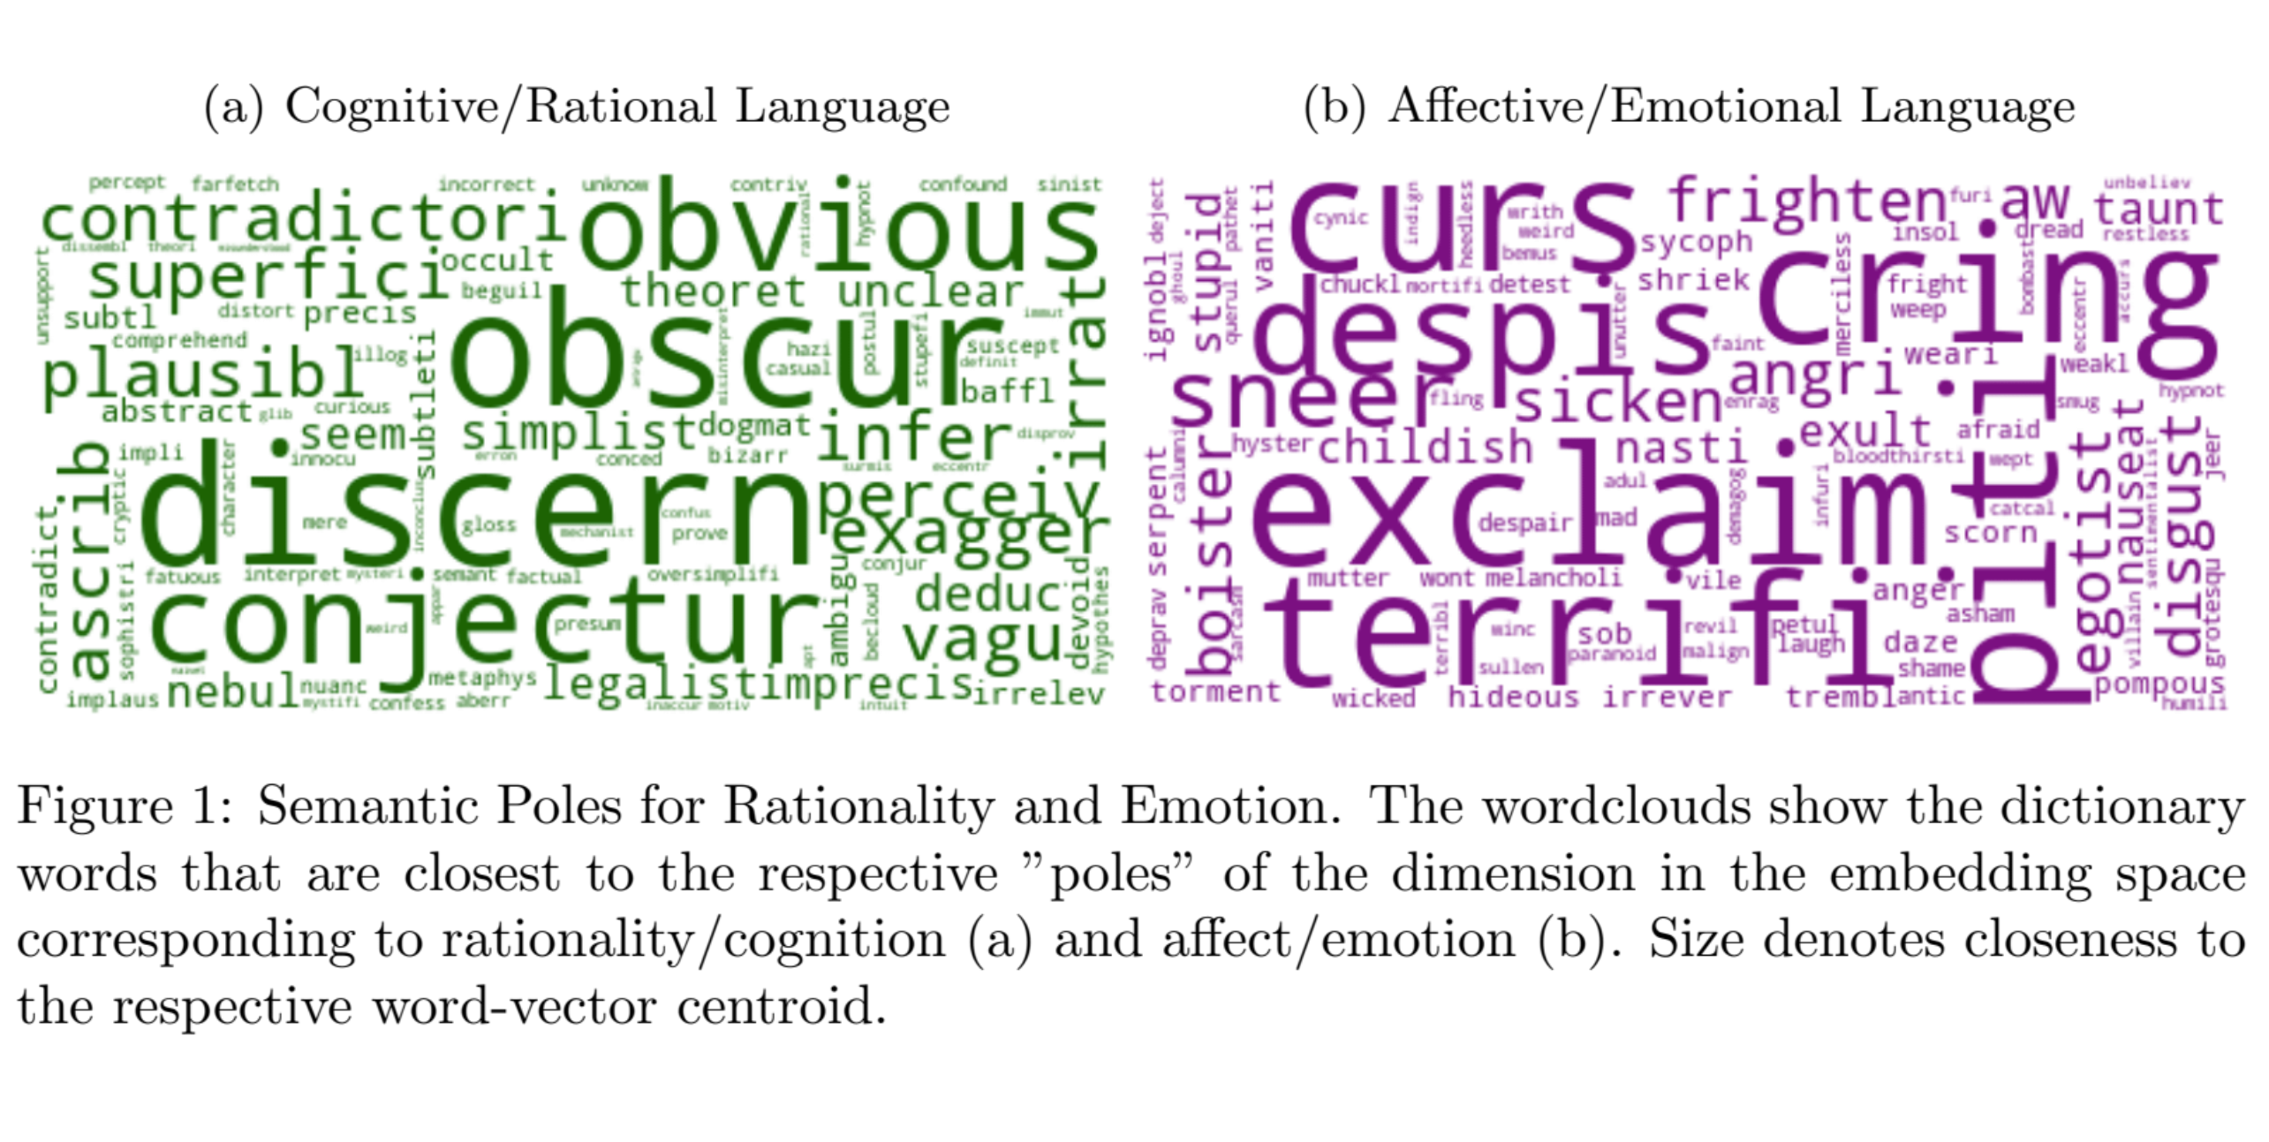
Linguistic Inquiry and Word Count Word Lists
LIWC Dictionary Words
The word clouds show the most frequent words in both word lists we used for our research

Slide 12
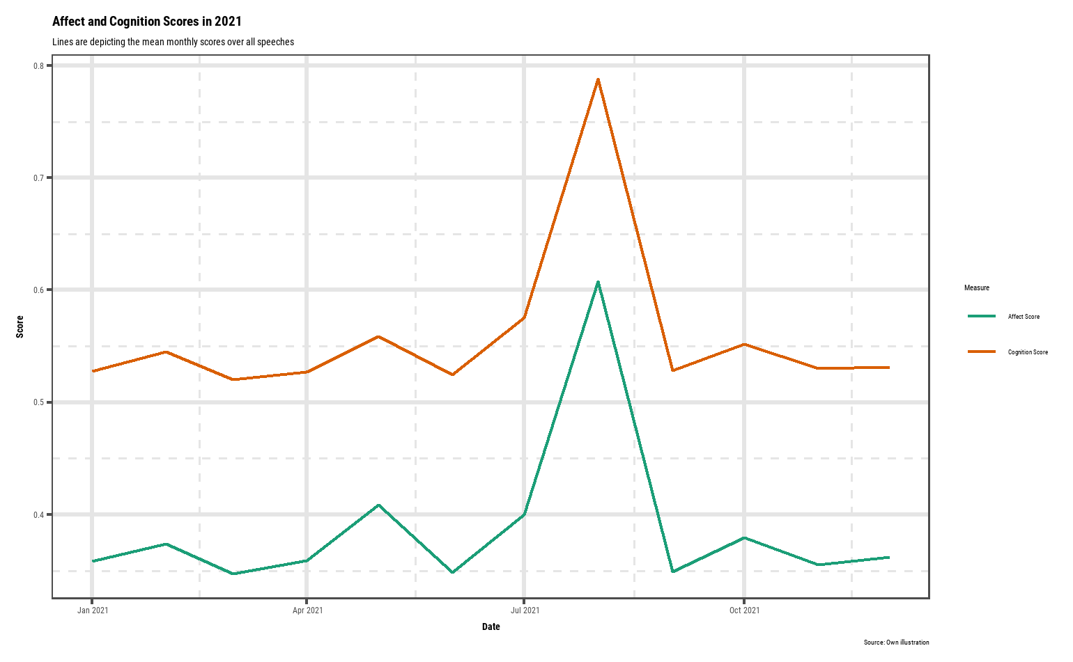
Affect and Cognition Over Time

Slide 13
Affect and Cognition in 2021

Slide 14
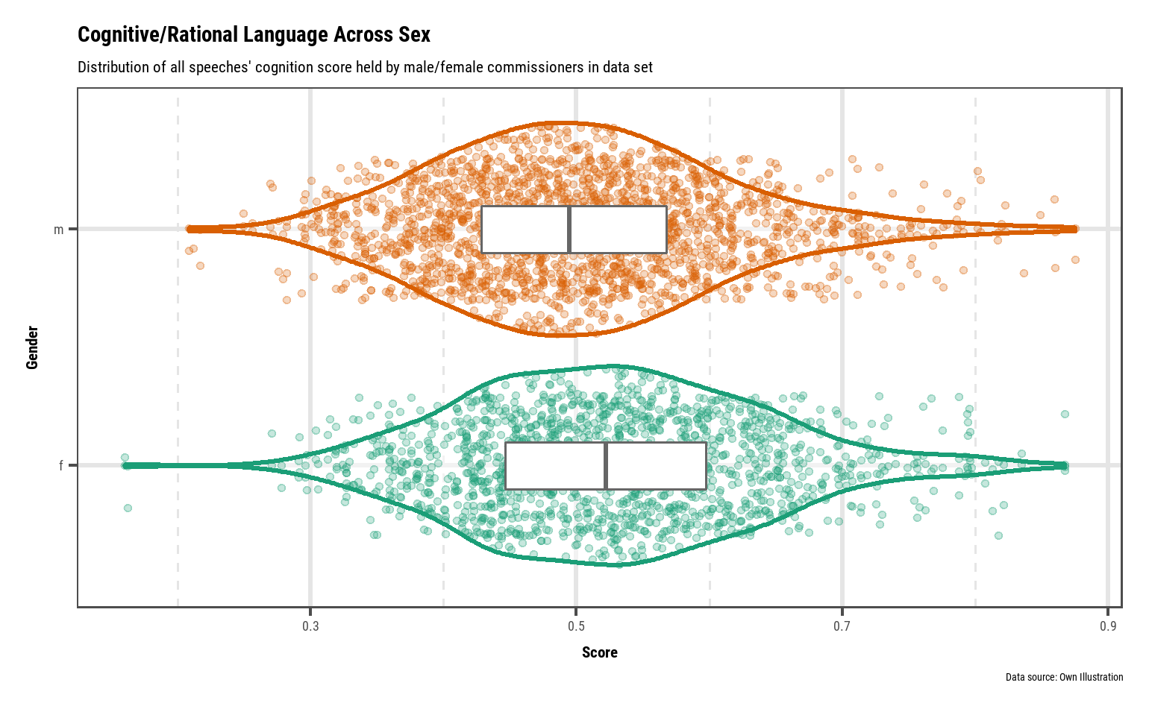
Cognition across gender

Slide 15
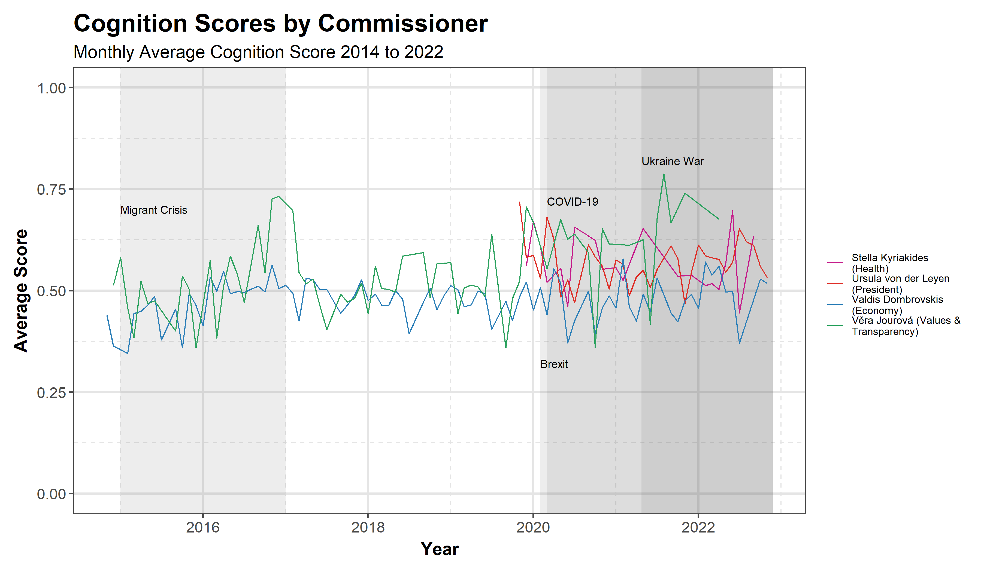
RQ1 – How does emotion in language vary across time and events?
RQ1:
Does emotion in language respond to major crises affecting the EU?
RQ2:
How does language vary across political topics?
RQ3:
How does emotion and reason vary by gender and political ideology of commissioners?
Highly emotive speeches are associated to major crisis events like COVID-19 outbreak and Ukraine war

Slide 16
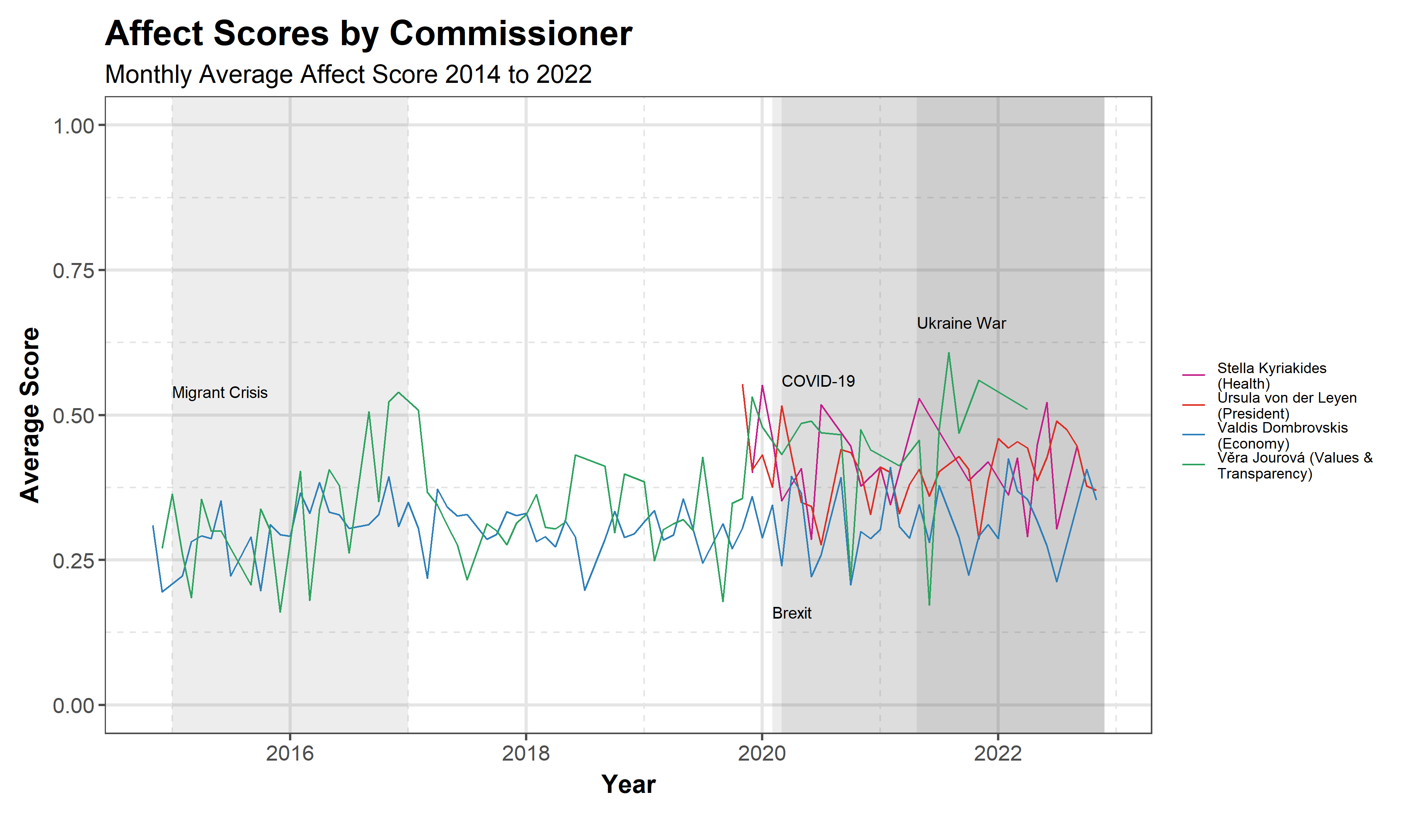
RQ1 – How does emotion in language vary across time and events?
RQ1:
Does emotion in language respond to major crises affecting the EU?
RQ2:
How does language vary across political topics?
RQ3:
How does emotion and reason vary by gender and political ideology of commissioners?
Commissioner speeches use more cognitive than affective language during major crisis events

Slide 17
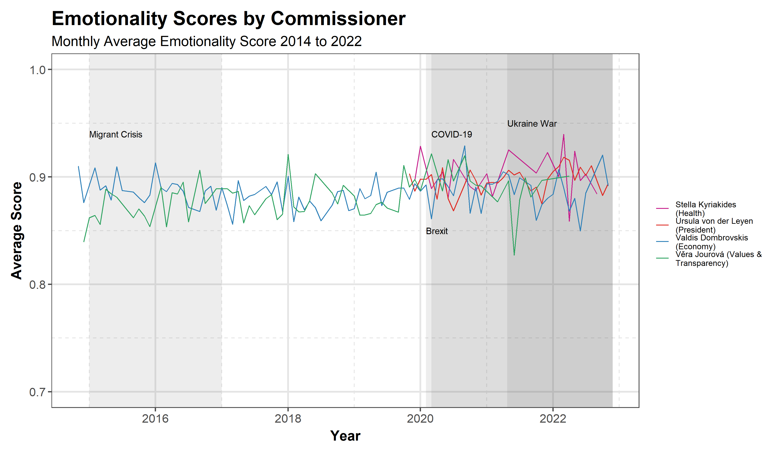
RQ1 – How does emotion in language vary across time and events?
RQ1:
Does emotion in language respond to major crises affecting the EU?
RQ2:
How does language vary across political topics?
RQ3:
How does emotion and reason vary by gender and political ideology of commissioners?
Commissioner speeches use more cognitive than affective language during major crisis events

Slide 18
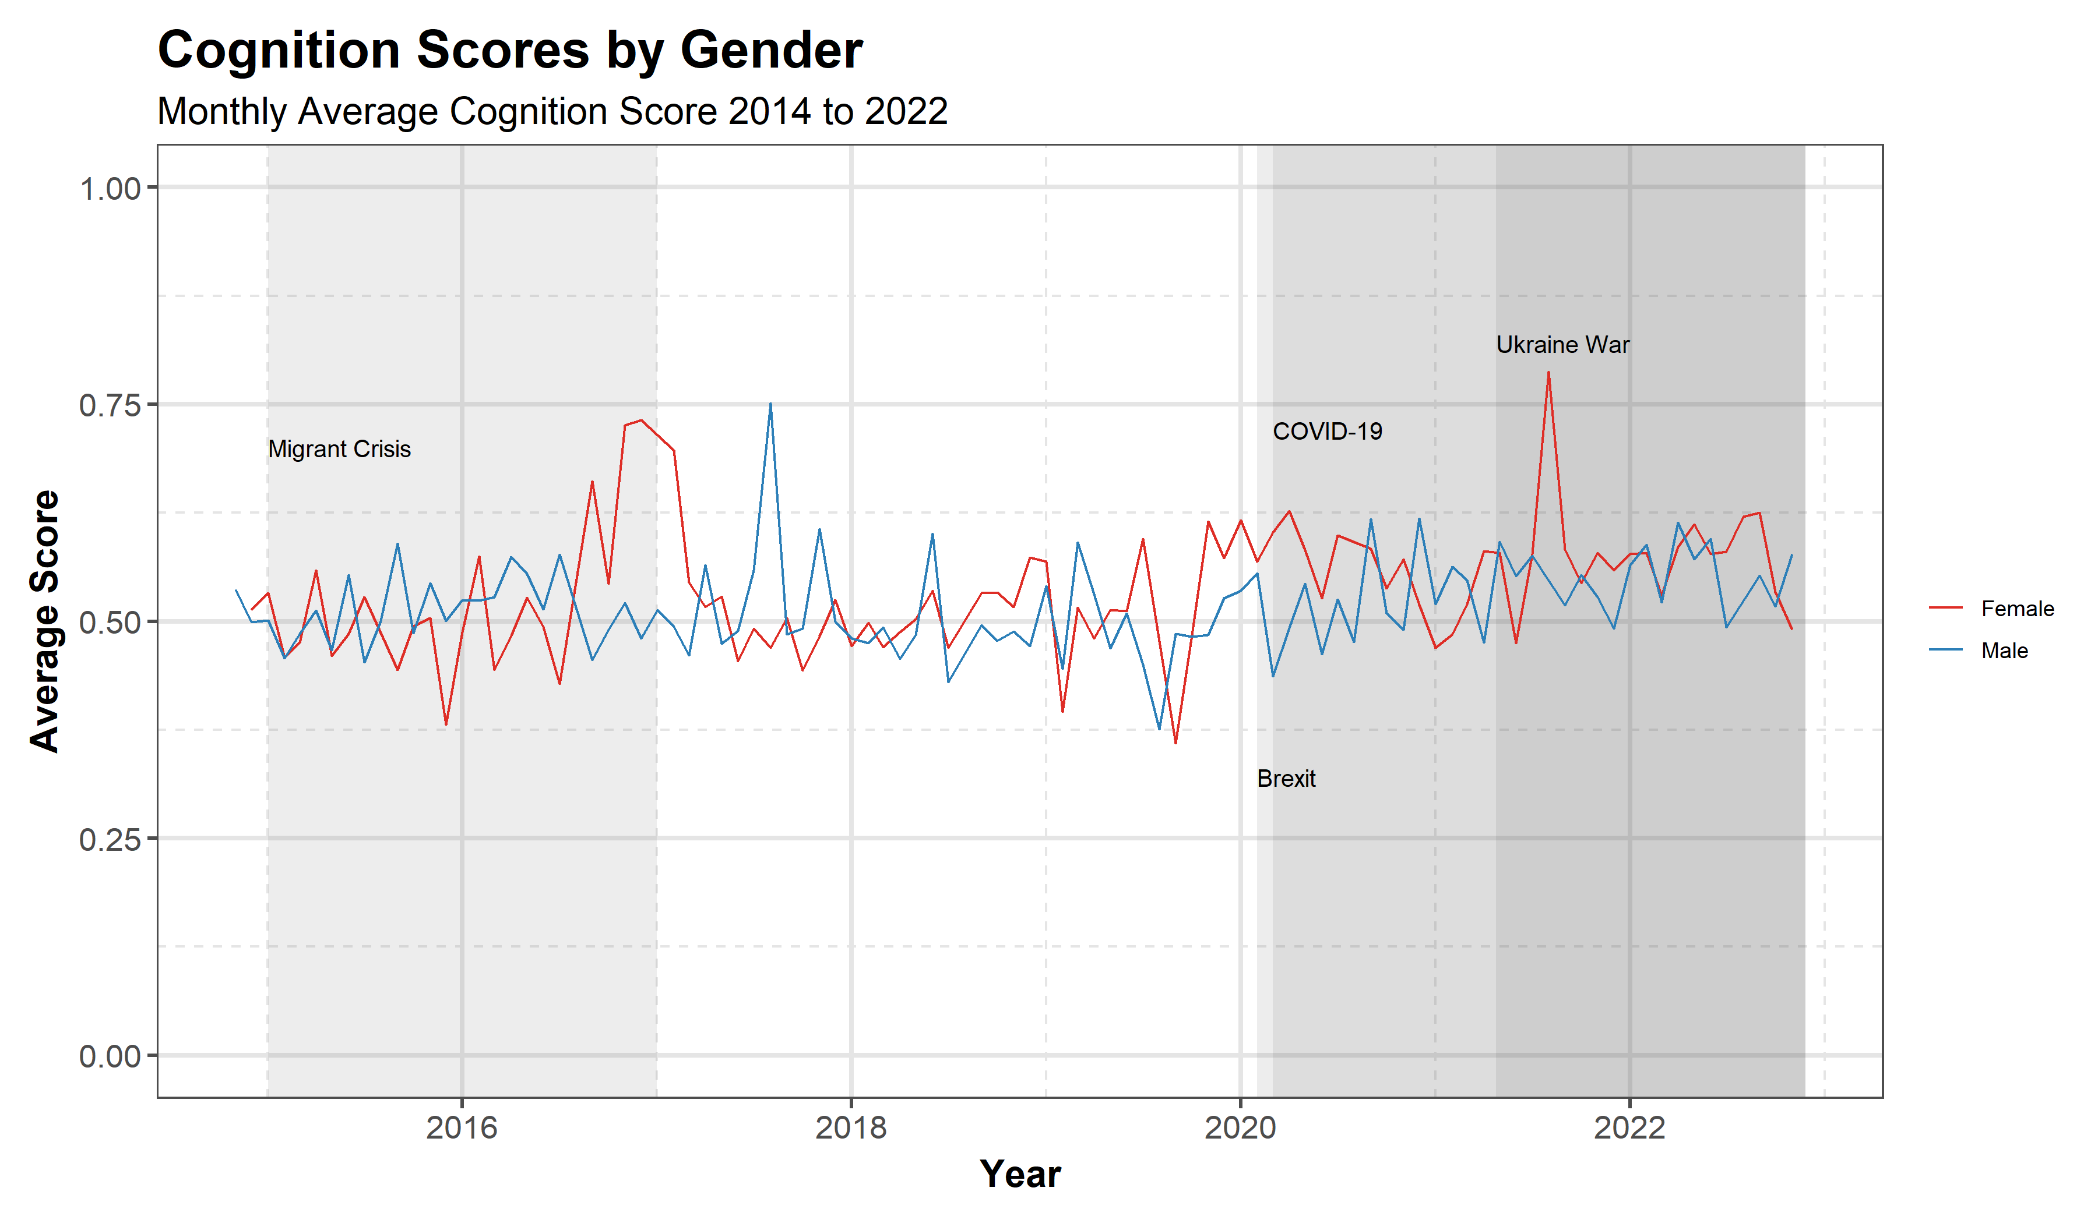
RQ1 – How does emotion in language vary across time and events?
RQ1:
Does emotion in language respond to major crises affecting the EU?
RQ2:
How does language vary across political topics?
RQ3:
How does emotion and reason vary by gender and political ideology of commissioners?
Highly emotive speeches are associated to major crisis events like COVID-19 outbreak and Ukraine war

Slide 19
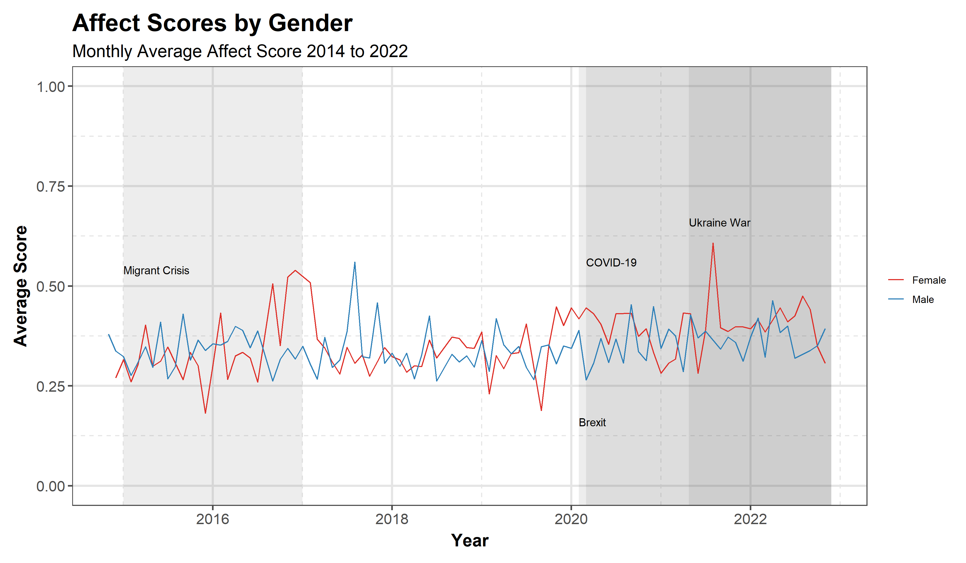
RQ1 – How does emotion in language vary across time and events?
RQ1:
Does emotion in language respond to major crises affecting the EU?
RQ2:
How does language vary across political topics?
RQ3:
How does emotion and reason vary by gender and political ideology of commissioners?
Commissioner speeches use more cognitive than affective language during major crisis events

Slide 20
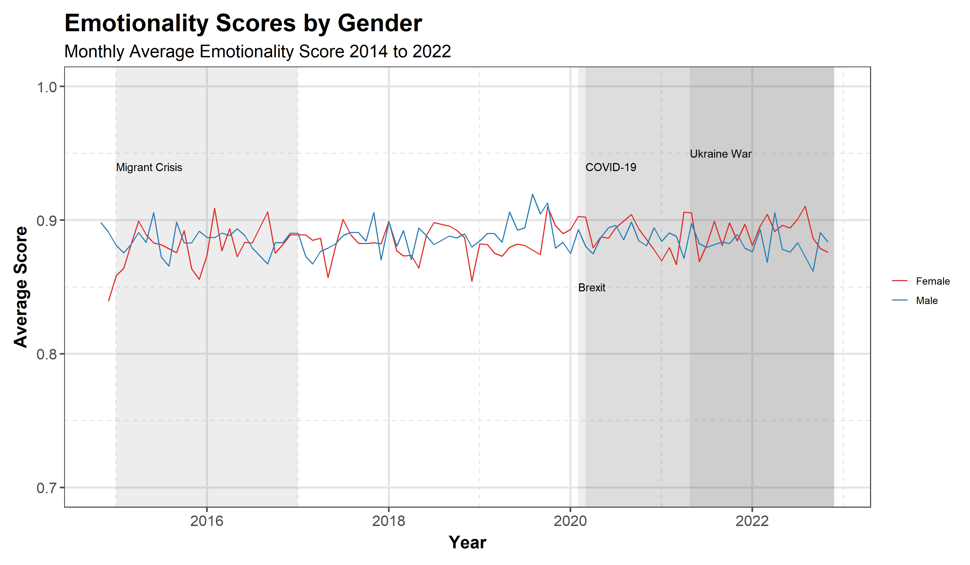
RQ1 – How does emotion in language vary across time and events?
RQ1:
Does emotion in language respond to major crises affecting the EU?
RQ2:
How does language vary across political topics?
RQ3:
How does emotion and reason vary by gender and political ideology of commissioners?
Commissioner speeches use more cognitive than affective language during major crisis events

Slide 21
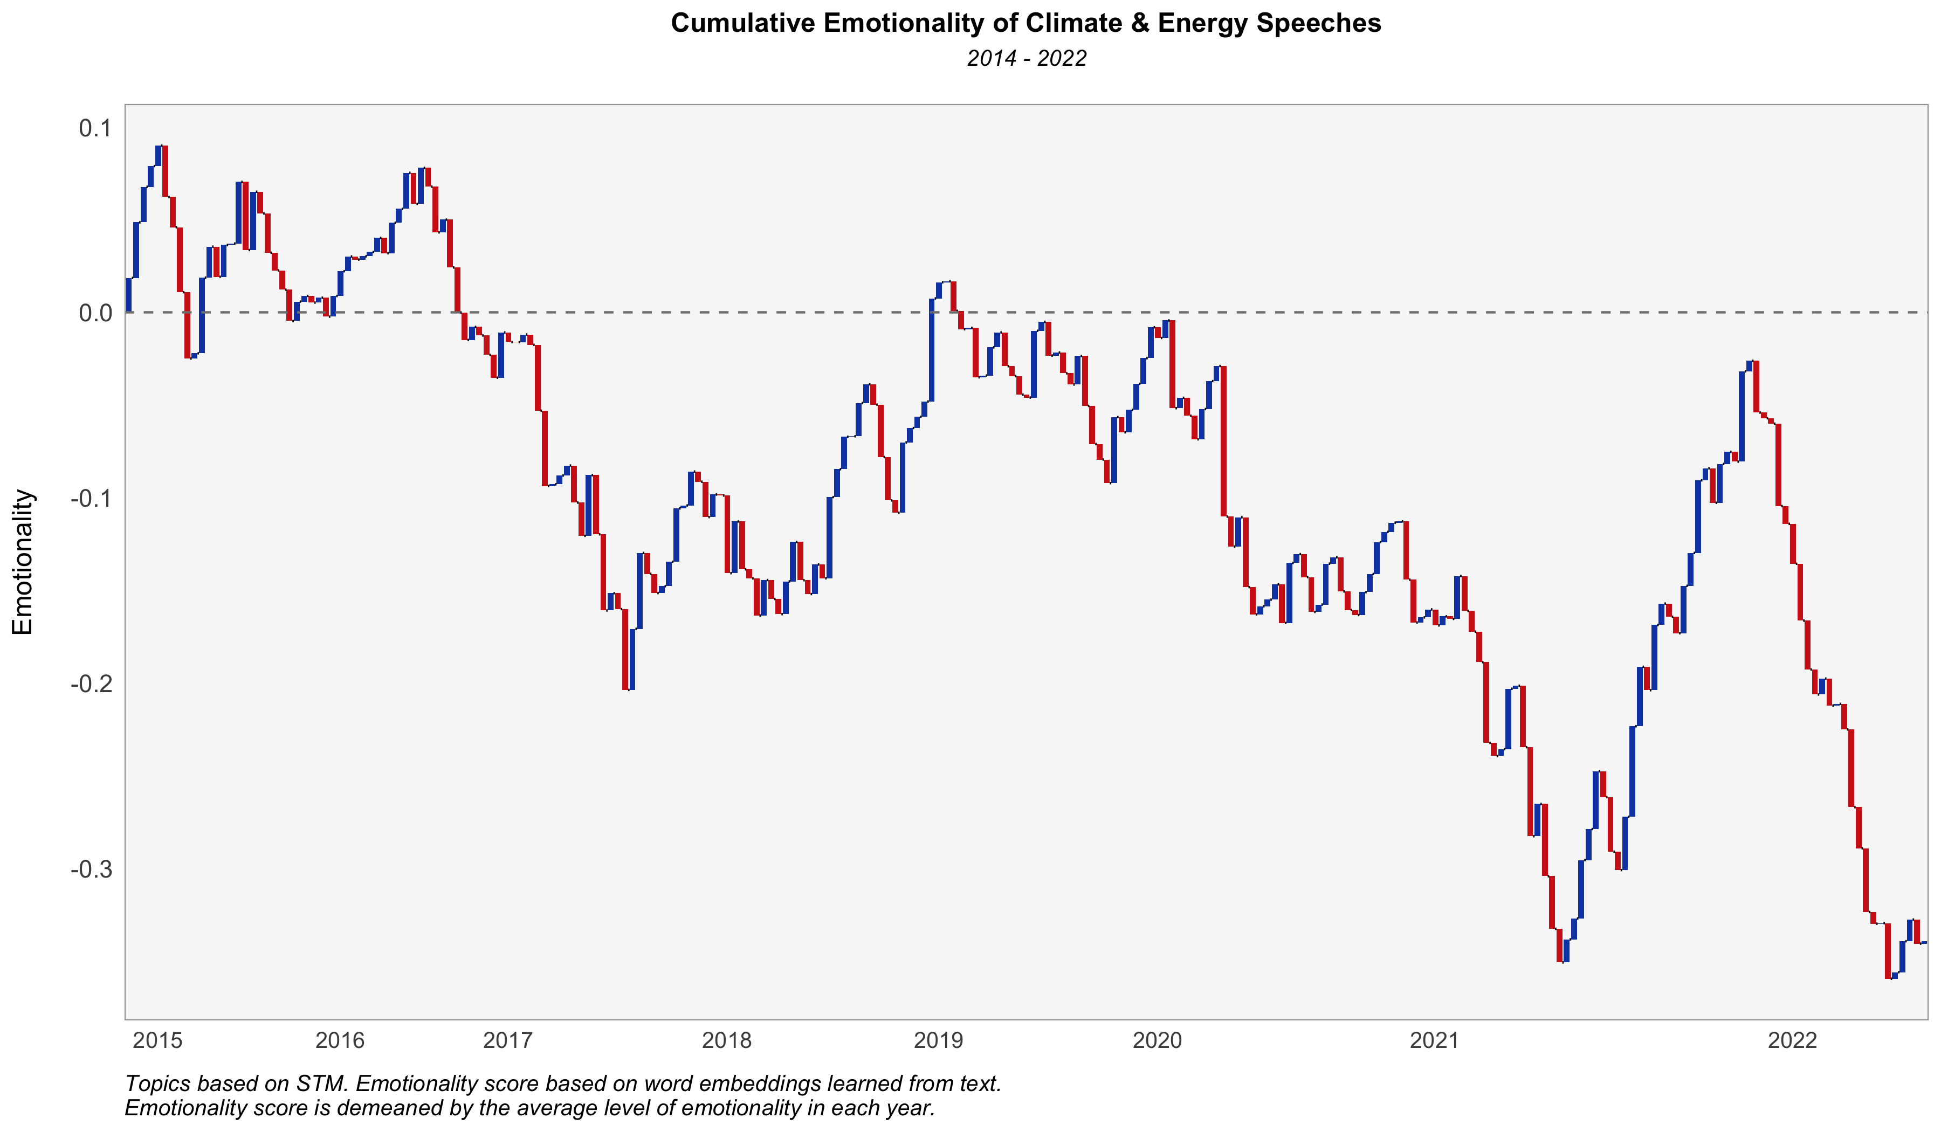
RQ2 – How does emotion in language vary across political topics?
RQ1:
Does emotion in language respond to major crises affecting the EU?
RQ2:
How does language vary across political topics?
RQ3:
How does emotion and reason vary by gender and political ideology of commissioners?

Slide 22
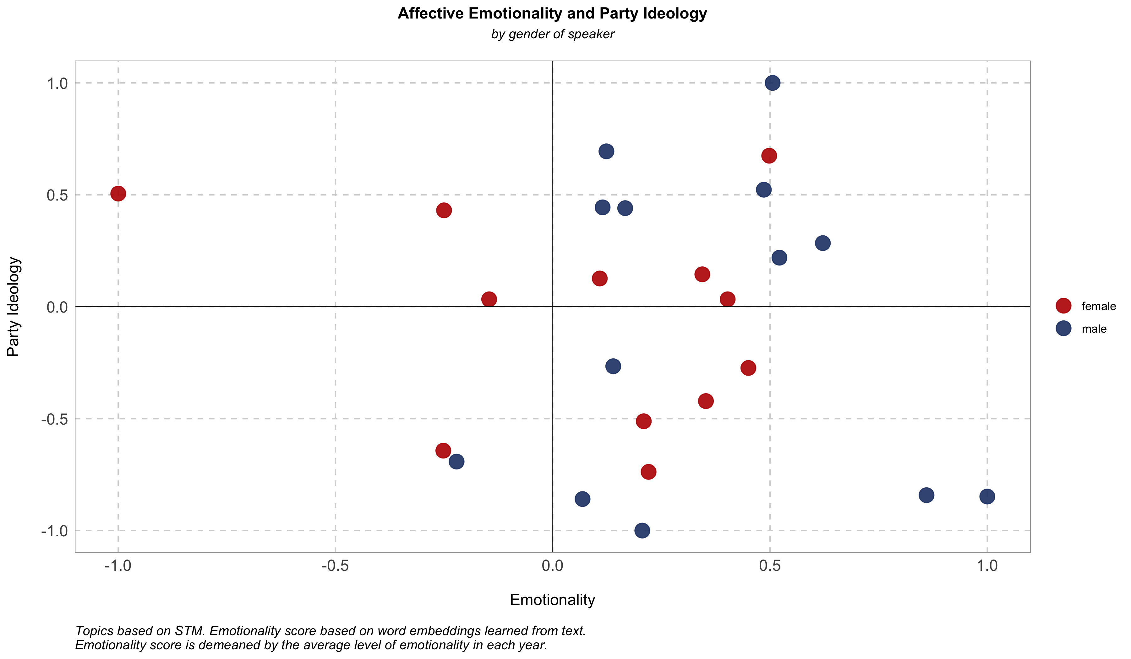
RQ3 – How does emotion and reason vary by gender and political ideology of commissioners?
RQ1:
Does emotion in language respond to major crises affecting the EU?
RQ2:
How does language vary across political topics?
RQ3:
How does emotion and reason vary by gender and political ideology of commissioners?

